Slide 1
Planning & Decision Making
Presented by :
Hem pd. Binadi
Sandace j. Shah

Slide 2
Topic….
Management By Objectives(MBO)
Meaning of Decision making
Types of Decision Making
Definition & Characteristics of Organization
Types of organization
Centralization Vs Decentralization

Slide 3
Management By Objectives(MBO)
- In 1954 Peter Ducker gives idea of MBO as managerial planning & control.
Sense of ownership
Communicates the goal, mission and objectives of the organization to lower level.
MBO can be considered as a cycle consisting of four phase : setting goals, developing action plan, periodic review and performance evaluation.

Slide 4
Key Features of MBO
the superior and the subordinate meet to discuss and set goals for the subordinate for a specified period of time.
both the superior and the subordinate attempt to establish goals that are realistic, challenging, clear, and comprehensive.
the standard for measuring and evaluating the goals and objectives are agreed upon.
Continue….

Slide 5
the superior and the subordinate establish some intermediate review dates when the goal will be re- examined.
the superior plays more of the coaching, counseling and supportive role.
the entire process focuses on results and on the counseling of the subordinates and not on activities, mistakes, and organizational requirements.

Slide 6
Advantages of MBO
it blends planning and control functions.
it emphasizes results rather then good intentions.
it encourages self- management and control through participation and commitment.

Slide 7
Weaknesses of MBO
it is time consuming process.
it does not work when conditions are unfavorable.

Slide 8
Meaning of Decision Making
Decision Making : it is the process of identifying and choosing alternative courses of action.
obtain complete and perfect information
eliminate uncertainty
evaluate everything rationally and logically
….and end up with a decision that best serves the interests of the organization
When faced with a decision situation managers should…..
Fig : the classical model of Decision Making

Slide 9
Basic elements of Decision Making
to make a decision between different course of action, the manager need information and the decision rules.
the decision maker should be aware on short- term and long- term impact of his/her decision.
a well identified decision maker or decision making body.
ensuring that the decision, once made, is known to all concerned i.e communication.
Cont……

Slide 10
a decision must be timely or well timed.
before making decision, decision maker should know the decision rules clearly, and to have necessary information at hand.

Slide 11
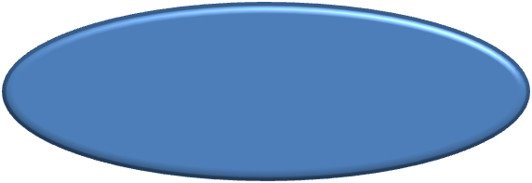

Type of Decision Making
Frequency
Nature
- Programmed Decision
- Non programmed Decision
- Operating Decision
- Strategic Decision
- Administrative Decision

Slide 12
Frequency
Programmed Decision
relate to the day to day running of an organization.
hence rules and guidelines are applied at the time of need.
source of information are clearly defined.
Non programmed Decision
required for non routine type of decision.
do not occur frequently and hence no ready made rules & decision.

Slide 13
Nature
Operating Decisions
day to day decision aiming for maximizing the efficiency and profitability of organization.
deals with internal organizational issues such as production schedules, inventory level, operational monitoring and control, sales and distribution schedules.
lower level managers takes these decisions.

Slide 14
Strategic Decision
deals with problems such as goals and objectives of organization, selection of a product-market mix, strategies for diversification, investment and expansion etc.
these are centralized and top level management are responsible for such decision.
Administrative Decision
it maintain a link and coordination between the strategic and operating decisions.
middle level manager are involved in such types of decision.
it deals with issues such as rules, procedures, information-flows, reward system, acquiring resources etc.

Slide 15
Organization

Slide 16

Characteristics of Organization

Slide 17
Types of Organization
Line structure
Line and staff structure
Functional structure
Matrix structure

Slide 18
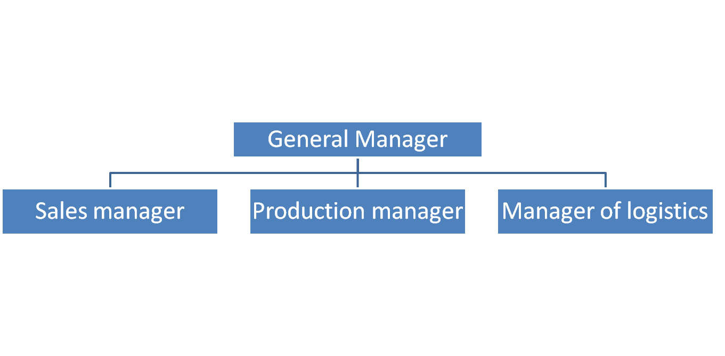
Line structure
it is oldest form of organization structure commonly known as scalar or military type of organization.
salespersons
Plant employees
Office Employees

Slide 19
Advantages: | Disadvantages:
Simplicity Quick decision making Flexibility Unified control | Rigidity and inflexibility overburdened superiors lack of specialization

Slide 20
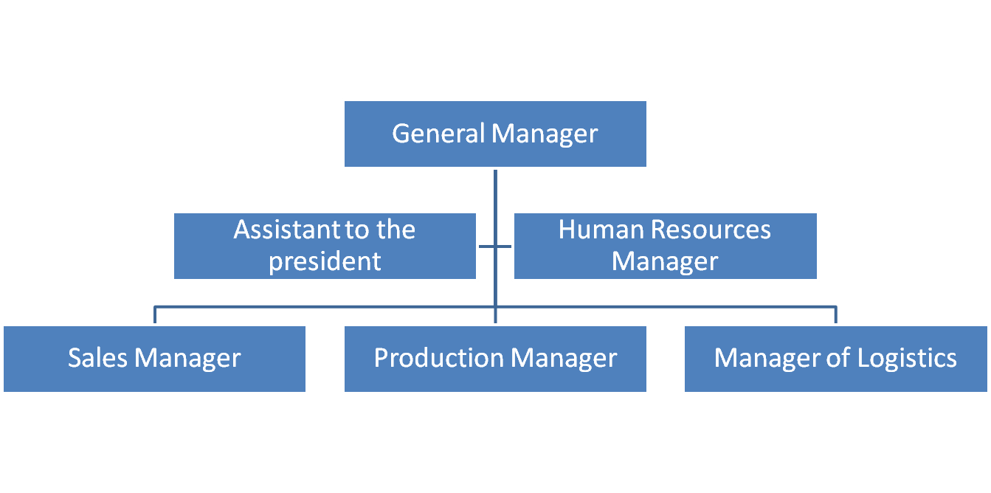
Line and staff structure
- Each person reports one and only superior.
salespersons
Plant employees
Office Employees

Slide 21
Advantages: | Disadvantages:
Making use of specialization More operating efficiency Prospects of career development | Confusion Conflict, rivalry and jealousy Tendency to enlarge the domain Suspicion and mistrust

Slide 22
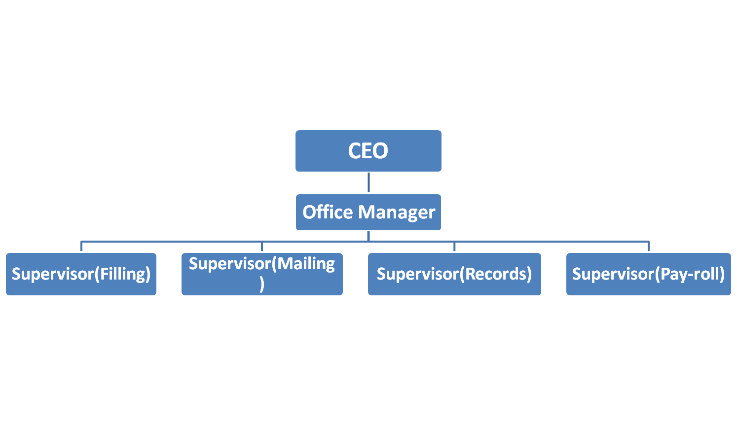
Functional structure
- Task is divided according to the type of work involved.
Clerical Workers

Slide 23
Advantages: | Disadvantages:
Use of specialist skills Command authority Job specialist | Multiple subordination line managers may loose interest

Slide 24
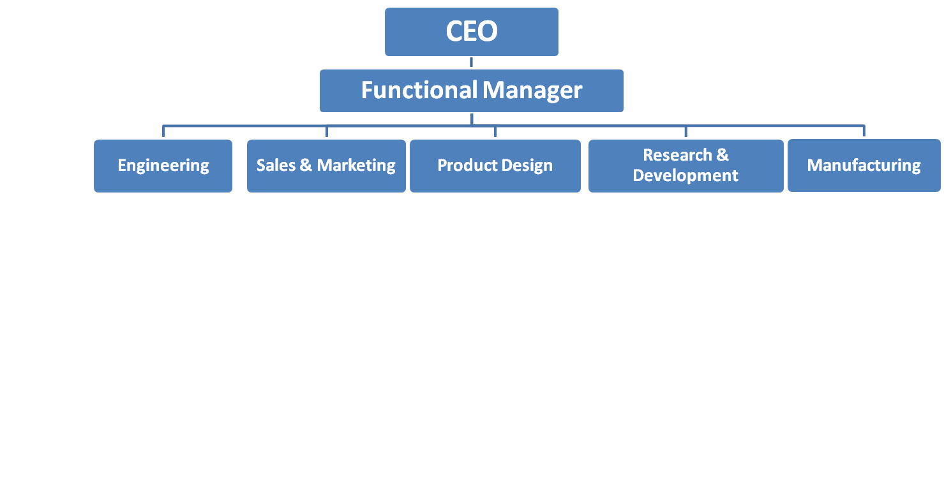
Matrix structure
Mixed form of organization in which functional & departmental forms overlap.
managers group people &responsibilities in twp simultaneously: by function & by product or work project.
Team [A]
Team [B]
Product team managers
Team [C]
Team [D]
Two boss employee
[…]
Product team

Slide 26
Centralization
The relative retention of decision- making authority by top management.
Authority and accountability remains at the top of the hierarchy.
Advantage
Chief executives enjoy power and prestige.
Uniformity of policies, practices, and decisions are fostered.
Full utilization of the main office facilities is realized.
Improved market responsiveness is obtained with greater centralization.

Slide 27
Continue…
Highly qualified specialists can be utilized because the scope and volume of their work ate sufficient to keep them busy.
Duplication of functions is minimized.
The danger of actions differing and getting off course is reduced.
Elaborate and extensive procedures and practices are not required.
A strong coordinated team of top management is developed.

Slide 28
Disadvantages
Time of employee is lost going to and from centralized activity to the department where the work is to be done.
Effort consuming inconvenience results, when the organization is spread over a wide is to be done.
The confidential nature of some of the information and records make it impractical to place them in a centralized locations.
Work in a centralized system is performed in the order of receipt rather then in the order of importance.

Slide 29
Continue….
Centralization results in overloaded top managers.
A tendency to shift the responsibility upward in the organization develops among employees.

Slide 30
Decentralization
Right, responsibility and decision making power are given to the lower level managers of the organization is known as decentralized organization.
This is required in fast changing environment so that decision could be made quickly.
Decision making and authority are spread throughout the organization.

Slide 31
Advantage
It stresses delegation of decision making and lightens the load of top management.
The development of generalists rather than specialists is encouraged.
Intimate personal ties and relationships are promoted, resulting in greater employee enthusiasm and coordination.
Familiarity with important aspects of special work I readily acquired.
Efficiency is increased since managers are near the activities for which they are held responsible.

Slide 32
For organizations having widespread units, managers can obtain full advantage of local conditions.
Challenges of decentralization
For its effectiveness, the employees must be well trained and educated, enhancing their decision making ability, hence time-consuming and costly affair.
Requires increased overhead and staff.
The cost and risk associated with such decision increases.
Duplication of work, manpower, equipment and technology because of work in different places.

